Slide 1
1587: COMMUNICATION SYSTEMS 1 Error detection and control
Dr. George Loukas
University of Greenwich, 2015-2016

Slide 2




Slide 3
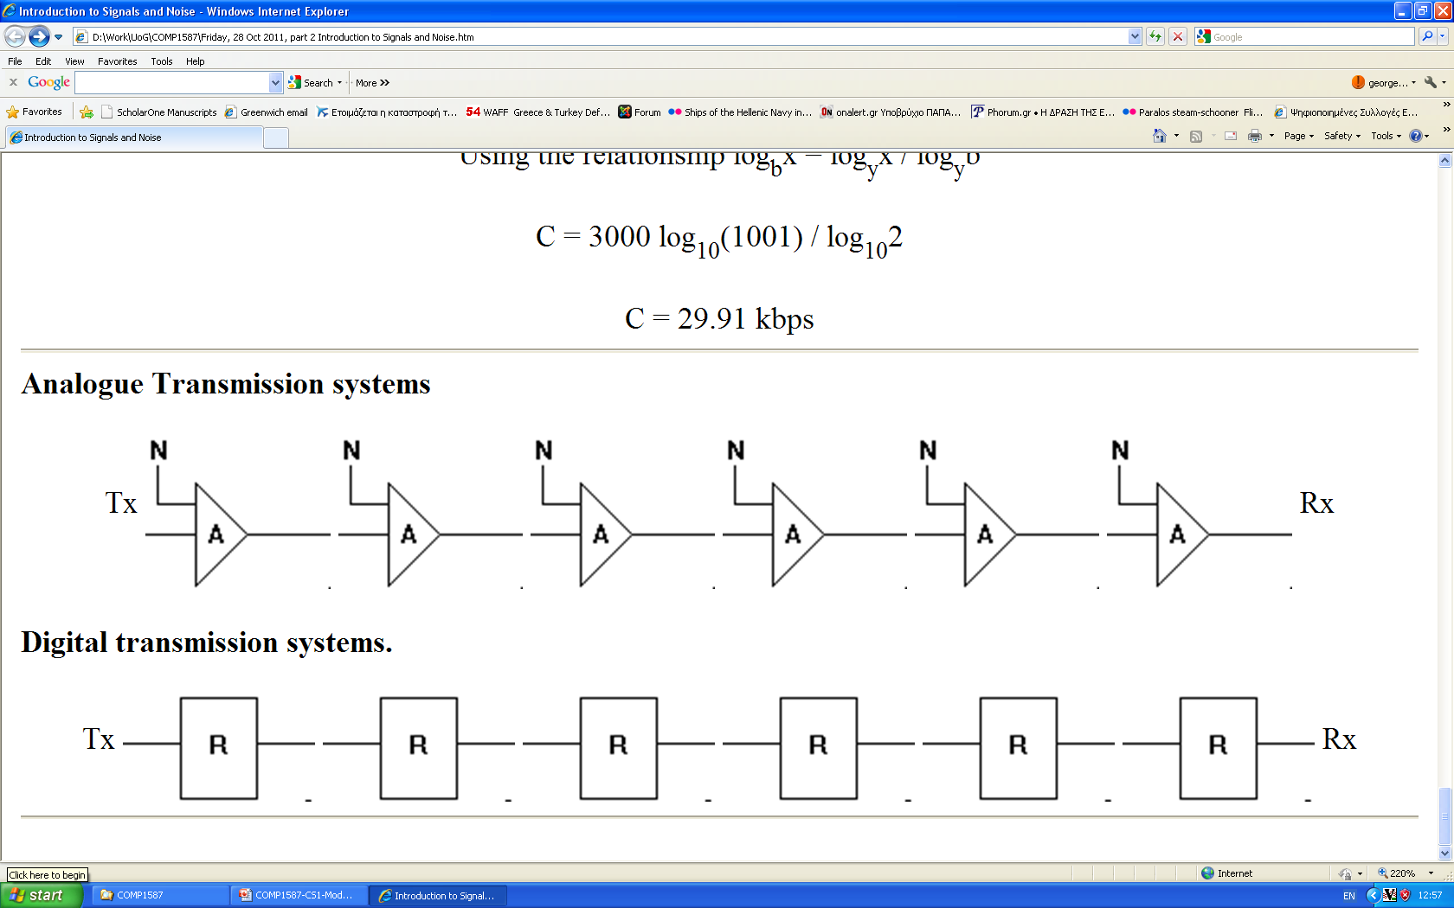
Signals Quick revision: Noise
Types of noise: Attenuation, Attenuation distortion, Cross-talk noise, Delay distortion, Impulse noise, Intermodulation noise, Thermal noise
Analogue
Transmission over a distance
50 km
50 km
Digital
50 km
50 km

Slide 4
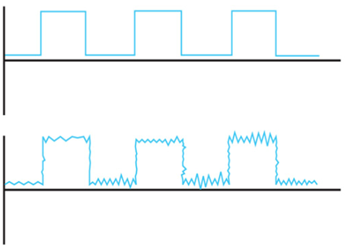
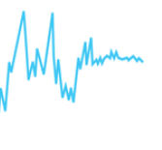
Errors in data communication
1
1
1
0
0
0
1
1
1
?
0
0
0
0

Slide 5





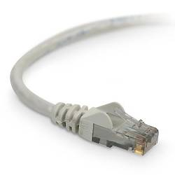

Errors in data communication
Extremely rare within a computer’s circuits, but quite frequent outside
Caused by electrical interference
(Large electric motors being switched on/off, microwave interfering with the wifi etc.)
…0111001…
…0100001…
__
Notes:
It can take decades of a modern PC’s continuous operation to have one accidental error. 10^-18

Slide 6
Types of errors
Sent
Received
…0101001…
Single-bit error
…0111001…
__
Usually caused by white noise
Notes:
In digital transmission systems, an error occurs when a bit is altered between transmission and reception; that is, a binary 1 is transmitted and a binary 0 is received, or a binary 0 is transmitted and a binary 1 is received. Two general types of errors can occur: single-bit errors and burst errors.
A single-bit error is an isolated error condition that alters one bit but does not affect nearby bits. A single-bit error can occur in the presence of white noise, when a slight random deterioration of the signal-to-noise ratio is sufficient to confuse the receiver's decision of a single bit.
A burst error of length B is a contiguous sequence of B bits in which the first and last bits and any number of intermediate bits are received in error. Burst errors are more common and more difficult to deal with. Burst errors can be caused by impulse noise, and by fading in a mobile wireless environment. Note that the effects of burst errors are greater at higher data rates.

Slide 7
Types of errors
Sent
Received
…0111001…
…0100101…
__
Burst error
…0000001…
__
Usually caused by impulse noise
Example: An impulse noise event lasts 1 ms. How many bits of the message may be affected? Assume a line of (1) 100 Kbps, (2) 10 Mbps
At 100 Kbps, the burst error is:
At 10 Mbps, the burst error is:
Notes:
In digital transmission systems, an error occurs when a bit is altered between transmission and reception; that is, a binary 1 is transmitted and a binary 0 is received, or a binary 0 is transmitted and a binary 1 is received. Two general types of errors can occur: single-bit errors and burst errors.
A single-bit error is an isolated error condition that alters one bit but does not affect nearby bits. A single-bit error can occur in the presence of white noise, when a slight random deterioration of the signal-to-noise ratio is sufficient to confuse the receiver's decision of a single bit.
A burst error of length B is a contiguous sequence of B bits in which the first and last bits and any number of intermediate bits are received in error. Burst errors are more common and more difficult to deal with. Burst errors can be caused by impulse noise, and by fading in a mobile wireless environment. Note that the effects of burst errors are greater at higher data rates.

Slide 8
In binary
0100100100100000011101110110000
1011011100111010000100000011000
0100100000010000100110000101110
1000010000001100110011011110111
0010001000000110110101111001001
0000001100010011010010111001001
1101000110100001100100011000010
1111001
0100100100100000011101110110000
1011011100111010000100000011000
0100100000011000110110000101110
1000010000001100110011011110111
0010001000000110110101111001001
0000001100010011010010111001001
1101000110100001100100011000010
1111001

Slide 9
PREVENT
DETECT
CONTROL
errors

Slide 10
Error Prevention
PREVENT
DETECT
Examples of preventive actions:
Replace older equipment
Improve cable’s shielding
Reduce the transmission speed
For wireless: Stay away from devices sharing the same wireless frequencies
…
CONTROL
Notes:
Cable shielding is usually braided strands of metal (copper, aluminium etc), covered with a jacket. The shield acts as a Faraday Cage to reduce electrical noise and electromagnetic radiation from interfering with other devices.

Slide 11
PREVENT
DETECT
CONTROL

Slide 12
Error Detection
Error-detecting code (check bits) added by the transmitter and checked by the receiver
Common methods:
Simple Parity
(also known as Vertical Redundancy Check)
Longitudinal Redundancy Check
(LRC, also known as Horizontal Parity)
Cyclic Redundancy Check (CRC)
Simple Parity
LRC
CRC
Notes:
Regardless of the design of the transmission system, there will be errors, resulting in the change of one or more bits in a transmitted frame. Error detection is performed by calculating an error-detecting code that is a function of the bits being transmitted. The code is appended to the transmitted bits. The receiver calculates the code based on the incoming bits and compares it to the incoming code to check for errors. A detected error occurs if and only if there is a mismatch. There is a probability that a frame contains errors and that the error-detecting scheme will detect that fact. Also have a residual error rate, being the probability that an error will be undetected despite the use of an error-detecting scheme.
CRC is the most elaborate among the ones in wide use today.

Slide 13
Error Detection: Simple Parity Check
Add one bit to the end of a block of data to create odd (or even) parity
ODD PARITY: odd number of 1s
add
to ensure odd number of 1s
1001011
1
add
to ensure odd number of 1s
1001010
0
or
EVEN PARITY: even number of 1s
add
to ensure even number of 1s
1001011
0
Notes:
The simplest and easiest to implement error-detecting scheme is to append a parity bit to the end of a block of data. The value of this bit is selected so that the character has an even number of 1s (even parity) or an odd number of 1s (odd parity).
Note, however, that if two (or any even number) of bits are inverted due to error, an undetected error occurs. Typically, even parity is used for synchronous transmission and odd parity for asynchronous transmission. The use of the parity bit is not foolproof, as noise impulses are often long enough to destroy more than one bit, particularly at high data rates.

Slide 14
Examples
EVEN PARITY
1111011
0
ODD PARITY
1001111
0
ODD PARITY
1000010
1
EVEN PARITY
0000000
0
EVEN PARITY
1001001
1
ODD PARITY
1111111
0

Slide 15
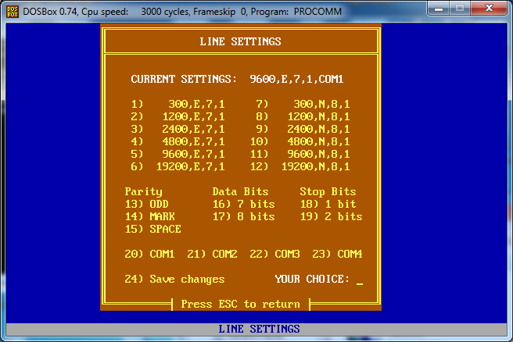
even parity

Slide 16
Error Detection: Simple Parity Check
ODD PARITY
…01110011…
…01010011…
__

Slide 17
Error Detection: Simple Parity Check
ODD PARITY
…01110011…
…01101011…
__

Slide 18
Error Detection: Simple Parity Check
If an odd number of errors occur, the recipient sees even number of 1s and knows that there must be an error.
Sent odd number of 1s
Received even number of 1s
1001011
1
1010111
1
But if an even number of errors occur, then there are still odd number of 1s and so odd parity fails to detect them:
Sent odd number of 1s
Received odd number of 1s
1001011
1
1010101
1
Notes:
Odd parity checking detects only odd number of errors. So, success rate is something around 50% and message is ~15% longer

Slide 19
PREVENT
Simple Parity
DETECT
CONTROL

Slide 20
Error Detection: LRC
Longitudinal Redundancy Check (or Horizontal Parity)
Group together codes in blocks
Add a parity bit for each row
Add a parity bit for each column
If any of the individual parity checks is violated, the error is detected
Notes:
A bit better than simple parity, in the sense that it can detect even errors too.

Slide 21
Error Detection: LRC
Group together codes in blocks
Add an even parity bit for each row
Add an even parity bit for each column
…1101011111111101010100011011…
1101011
1
1111111
1
0101010
1
0011011
0
0
1
0
0
1
0
1
1
Block Check Character

Slide 22
Error Detection: LRC
Original message we wanted to send
…1101011111111101010100011001…
After including the LRC parity bits, the message is now much longer:
…1101011111111111010101010011001001001011…
1101011
1
1111111
1
0101010
1
0011011
0
0
1
0
0
1
0
1
1

Slide 23
Error Detection: LRC
Example of successful detection:
Although parity of all rows is even (and simple parity would have missed the errors), the parity of two of the columns is now odd.
Sent
Received
1101011
1
1101011
1
1111111
1
1001111
1
0101010
1
0101010
1
0011001
1
0011001
1
01001110
01001110

Slide 24
Error Detection: LRC
Example of failure to detect the errors:
Despite four errors, parity is still even across all rows and columns.
Sent
Received
1101011
1
1011011
1
1111111
1
1001111
1
0101010
1
0101010
1
0011001
1
0011001
1
01001110
01001110
Notes:
LRC success rate is about 80%, but message is now 40% longer.

Slide 25
PREVENT
Simple Parity
LRC
DETECT
CONTROL

Slide 26

Error Detection: CRC
Cyclic Redundancy Check:
For every k bits of data generate an n-bit frame check sequence (FCS)
Transmit k+n bits which is exactly divisible by some predetermined number
Receiver divides frame by that number. If remainder is not 0, there is an error
11010111111110100101010110 … 1010101
110000 … 1111
k bits of data (e.g. 1,000 bits)
n bits FCS (usually 8 - 32 bits)
Designed by Wesley Peterson in 1961
Notes:
One of the most common, and one of the most powerful, error-detecting codes is the cyclic redundancy check (CRC), which can be described as follows. Given a k-bit block of bits, or message, the transmitter generates an (n – k)-bit sequence, known as a frame check sequence (FCS), such that the resulting frame, consisting of n bits, is exactly divisible by some predetermined number. The receiver then divides the incoming frame by that number and, if there is no remainder, assumes there was no error. Can state this procedure in three equivalent ways: modulo 2 arithmetic, polynomials, and digital logic, as detailed in Stallings DCC9e chapter 6.3. Comes down to working out what remainder exists when divide data by desired number, and using that as the FCS value appended to the data to form the block.
Almost 100% success rate.

Slide 27
Error Detection: CRC
An Example
data
101001101
Treat the data as a large polynomial
1·x⁸+0·x⁷+1·x⁶+0·x⁵+0·x⁴+1·x³+1·x²+0·x¹+1·x⁰
Divide by given generating polynomial
e.g. by x¹⁶+x¹⁵+x²+1 (CRC-16)
Append the remainder of the division to the end of the original data and then send
The recipient divides the incoming data by the same generating polynomial. If there is a remainder, then there is an error

Slide 28
Error Detection: CRC
Examples of standard generating polynomials:
x¹²+x¹¹+x³+x²+x+1 (CRC-12)
x¹⁶+x¹⁵+x²+1 (CRC-16)
x¹⁶+x¹⁵+x⁵+1 (CRC-CCITT)
x³²+x²⁶+x²³+x²²+x¹⁶+x¹²+x¹¹+x¹⁰+x⁸+x⁷+x⁵+x⁴+x²+x+1 (CRC-32)
CRC is suitable for accidental communication errors, but not for intentional errors (e.g. due to hacking)

Slide 29
PREVENT
Simple Parity
LRC
CRC
DETECT
CONTROL

Slide 30

5 minutes

Slide 31
PREVENT
Simple Parity
LRC
CRC
DETECT
CONTROL
Notes:
Once the receiver detects an error, there are three options:
Do nothing
Request retransmission
Try to correct it

Slide 32

Error Control: Do nothing
Not as bad as it sounds if probability of error is very low (e.g. in fibre-optic communications)

Slide 33
PREVENT
Simple Parity
LRC
CRC
DETECT
CONTROL
Do nothing

Slide 34
Error Control: Request retransmission
The most common form of error control: Automatic Repeat Request (ARQ)
Typical examples:
Stop-and-Wait
Sliding window

Slide 35
PREVENT
Simple Parity
LRC
CRC
DETECT
CONTROL
Retransmit
Do nothing

Slide 36
Error Control: Stop-and-Wait
The transmitter sends a message. Then stops and waits for an acknowledgment
If an acknowledgement (ACK) is received, send the next data
If a negative acknowledgement (NAK) is received, send again the same data

Slide 37
Error Control: Stop-and-Wait
Example
Sender
Receiver
data sent
DATA
data received OK
ACK sent
ACK
ACK received
DATA
next data received with error
next data sent
NACK sent
NACK
DATA
NACK received
data re-sent
data received OK
Notes:
Often used when a fast device sends to a slow device, e.g. printer and computer
simple to implement but very inefficient, because only one packet can be sent at a time
obvious solution: allow multiple packets to be in transit at the same time

Slide 38
PREVENT
Simple Parity
LRC
CRC
DETECT
CONTROL
Stop and Wait
Retransmit
Do nothing

Slide 39
Error Control: Sliding Window
Allows multiple numbered frames to be in transit
receiver has buffer W frames long
transmitter sends up to W frames without ACK
ACK includes number of next frame expected
k-bit Sequence number (0 to 2^{k} – 1)
Receiver can ACK frames without permitting further transmission (“Receive Not Ready”) and must send a normal acknowledge to resume
Notes:
The essence of the problem described so far is that only one frame at a time can be in transit. Efficiency can be greatly improved by allowing multiple frames to be in transit at the same time. Consider two stations, A and B, connected via a full-duplex link. Station B allocates buffer space for W frames. Thus, B can accept W frames, and A is allowed to send W frames without waiting for any acknowledgments. To keep track of which frames have been acknowledged, each is labeled with a k-bit sequence number. This gives a range of sequence numbers of 0 through 2^{k} – 1, and frames are numbered modulo 2^{k}, with a maximum window size of 2^{k} – 1. The window size need not be the maximum possible size for a given sequence number length k. B acknowledges a frame by sending an acknowledgment that includes the sequence number of the next frame expected. This scheme can also be used to acknowledge multiple frames, and is referred to as sliding-window flow control. Most data link control protocols also allow a station to cut off the flow of frames from the other side by sending a Receive Not Ready (RNR) message, which acknowledges former frames but forbids transfer of future frames. At some subsequent point, the station must send a normal acknowledgment to reopen the window. If two stations exchange data, each needs to maintain two windows, one for transmit and one for receive, and each side needs to send the data and acknowledgments to the other. To provide efficient support for this requirement, a feature known as piggybacking is typically provided. Each data frame includes a field that holds the sequence number of that frame plus a field that holds the sequence number used for acknowledgment.

Slide 40
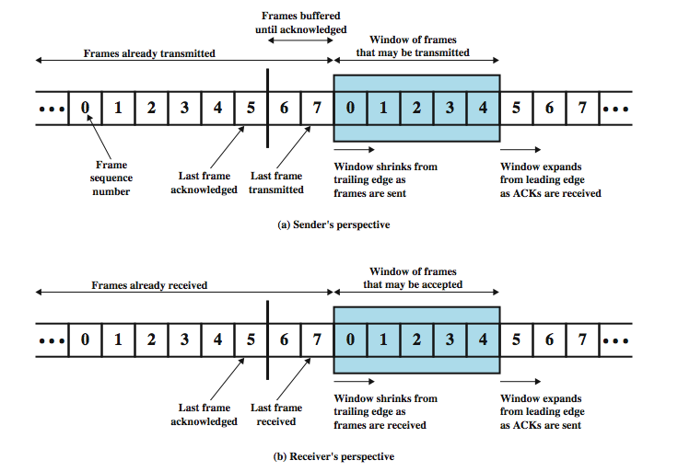
Sliding Window Diagram
Notes:
Stallings DCC9e Figure 7.3 depicts the sliding-window process. It assumes the use of a 3-bit sequence number, so that frames are numbered sequentially from 0 through 7, and then the same numbers are reused for subsequent frames. The shaded rectangle indicates the frames that may be sent; in this figure, the sender may transmit five frames, beginning with frame 0. Each time a frame is sent, the shaded window shrinks; each time an acknowledgment is received, the shaded window grows. Frames between the vertical bar and the shaded window have been sent but not yet acknowledged. As we shall see, the sender must buffer these frames in case they need to be retransmitted.
Sliding-window flow control is potentially much more efficient than stop-and-wait flow control. The reason is that, with sliding-window flow control, the transmission link is treated as a pipeline that may be filled with frames in transit. In contrast, with stop-and-wait flow control, only one frame may be in the pipe at a time.

Slide 41
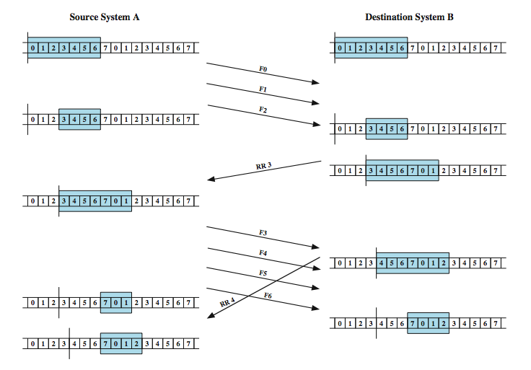
Sliding Window Example
Notes:
An example is shown in Stallings DCC9e Figure 7.4. The example assumes a 3-bit sequence number field and a maximum window size of seven frames. Initially, A and B have windows indicating that A may transmit seven frames, beginning with frame 0 (F0). After transmitting three frames (F0, F1, F2) without acknowledgment, A has shrunk its window to four frames and maintains a copy of the three transmitted frames. The window indicates that A may transmit four frames, beginning with frame number 3. B then transmits an RR (receive ready) 3, which means "I have received all frames up through frame number 2 and am ready to receive frame number 3; in fact, I am prepared to receive seven frames, beginning with frame number 3." With this acknowledgment, A is back up to permission to transmit seven frames, still beginning with frame 3; also A may discard the buffered frames that have now been acknowledged. A proceeds to transmit frames 3, 4, 5, and 6. B returns RR 4, which acknowledges F3, and allows transmission of F4 through the next instance of F2. By the time this RR reaches A, it has already transmitted F4, F5, and F6, and therefore A may only open its window to permit sending four frames beginning with F7.

Slide 42
PREVENT
Simple Parity
LRC
CRC
DETECT
CONTROL
Stop and Wait
Sliding Window
Retransmit
Do nothing

Slide 43
Error Control: Go-back-N
Example
Sender
Receiver
data1 sent
DATA1
data2 sent
DATA2
ACK1
DATA3
data3 sent
ACK1 sent
data4 sent
NACK2
DATA4
NACK2 sent
ACK1 received
DATA5
data5 sent
NACK2 received
DATA2
data2 re-sent
DATA3
data3 re-sent
data4 re-sent
ACK2 sent
ACK2
...
data5 re-sent
ACK3 sent
ACK3
Notes:
Special case of sliding window, with transmit window n and receive window size of 1.
The receiver process keeps track of the sequence number of the next frame it expects to receive, and sends that number with every ACK it sends. The receiver will ignore any frame that does not have the exact sequence number it expects – whether that frame is a "past" duplicate of a frame it has already ACK'ed or whether that frame is a "future" frame past the last packet it is waiting for. Once the sender has sent all of the frames in its window, it will detect that all of the frames since the first lost frame are outstanding, and will go back to sequence number of the last ACK it received from the receiver process and fill its window starting with that frame and continue the process over again.
Go-Back-N ARQ is a more efficient use of a connection than Stop-and-Wait, since unlike waiting for an acknowledgement for each packet, the connection is still being utilized as packets are being sent. In other words, during the time that would otherwise be spent waiting, more packets are being sent. However, this method also results in sending frames multiple times – if any frame was lost or damaged, or the ACK acknowledging them was lost or damaged, then that frame and all following frames in the window (even if they were received without error) will be re-sent. To avoid this, Selective Repeat ARQ was developed.
TCP/IP uses a variant of this to ensure safe delivery over the Internet.

Slide 44
PREVENT
Simple Parity
LRC
CRC
DETECT
CONTROL
Stop and Wait
Sliding Window
Retransmit
Go-back-N
Do nothing

Slide 45
Error Control: Selective-Reject
Example
Sender
Receiver
data1 sent
DATA1
data2 sent
DATA2
DATA3
data3 sent
ACK1 sent
ACK1
DATA4
data4 sent
NACK2
NACK2 sent
ACK1 received
ACK3
DATA5
data5 sent
NACK2 received
ACK4
DATA2
data2 re-sent
ACK5
ACK2 sent
ACK2
Notes:
The sender sends a number of frames specified by a window size even after a frame loss. Unlike Go-back-N, it will continue to accept and acknowledge frames sent after an initial error; this is the general case of the sliding window protocol with both transmit and receive window sizes greater than 1.
The receiver process keeps track of the sequence number of the earliest frame it has not received, and sends that number with every ACK it sends. If a frame from the sender does not reach the receiver, the sender continues to send subsequent frames until it has emptied its window. The receiver continues to fill its receiving window with the subsequent frames, replying each time with an ACK containing the sequence number of the earliest missing frame. Once the sender has sent all the frames in its window, it re-sends the frame number given by the ACKs, and then continues where it left off.

Slide 46
PREVENT
Simple Parity
LRC
CRC
DETECT
CONTROL
Stop and Wait
Sliding Window
Retransmit
Go-back-N
Selective Reject
Do nothing

Slide 47
Error Control: Forward Error Correction
In some applications it may not be a good idea to request retransmission
error rate is high and causes too many retransmissions (wireless)
propagation delay very long (satellite)
transmission needs to be as close to real-time as possible (digital TV)
So, the receiver needs to correct the errors
long delay
Notes:
Error detection is a useful technique, found in data link control protocols, such as HDLC, and in transport protocols, such as TCP. However, correction of errors using an error-detecting code, requires that block of data be retransmitted. For wireless applications this approach is inadequate for two reasons:
1. The bit error rate on a wireless link can be quite high, which would result in a large number of retransmissions.
2. In some cases, especially satellite links, the propagation delay is very long compared to the transmission time of a single frame. With a long data link, an error in a single frame necessitates retransmitting many frames.
Instead, it would be desirable to enable the receiver to correct errors in an incoming transmission on the basis of the bits in that transmission. Error correction operates in a fashion similar to error detection but is capable of correcting certain errors in a transmitted bit stream.
Transmitting data from NASA to a Martian probe takes several minutes and there is a high probability of error.

Slide 48
Forward Error Correction Process
adds redundancy to transmitted message
(this makes it possible to deduce original message despite some errors)
block error correction code
map k-bit input onto an n-bit codeword
each codeword is unique
if invalid codeword is received, assume input codeword is the valid codeword closest to received codeword
Notes:
In essence, error correction works by adding redundancy to the transmitted message. The redundancy makes it possible for the receiver to deduce what the original message was, even in the face of a certain level of error rate. In this section we look at a widely used form of error-correcting code known as a block error-correcting code. If wish to transmit blocks of data of length k bits, so map each k-bit sequence into a unique n-bit codeword, which differ significantly from each other. Typically, each valid codeword reproduces the original k data bits and adds to them (n – k) check bits to form the n-bit codeword. Then if an invalid codeword is received, assume the valid codeword is the one that is closest to it, and use the input bit sequence associated with it.
The ratio of redundant bits to data bits, (n – k)/k, is called the redundancy of the code, and the ratio of data bits to total bits, k/n, is called the code rate. The code rate is a measure of how much additional bandwidth is required to carry data at the same data rate as without the code. For example, a code rate of 1/2 requires double the transmission capacity of an uncoded system to maintain the same data rate.

Slide 49
Forward Error Correction simple example
A | 00000
B | 00111
C | 11001
D | 11110
But we received
00100
Out of the four options, the closest is 00000. So, we assume it is A.

Slide 50
Error Detection & Control Process
k bits
DATA
DATA
FEC encoder
No error or
correctable error
Add check bits
DATA + check bits
codeword
decoder
Error detectable
but not correctable
n bits
DATA + check bits
Sender
Receiver
Notes:
For a given frame of bits, additional bits that constitute an error-detecting code are added by the transmitter. This code is calculated as a function of the other transmitted bits. Typically, for a data block of k bits, the error-detecting algorithm yields an error-detecting code of n – k bits, where (n – k) < k. The error-detecting code, also referred to as the check bits, is appended to the data block to produce a frame of n bits, which is then transmitted. The receiver separates the incoming frame into the k bits of data and (n – k) bits of the error-detecting code. The receiver performs the same error-detecting calculation on the data bits and compares this value with the value of the incoming error-detecting code. A detected error occurs if and only if there is a mismatch.
Stallings DCC9e figure 6.7 shows in general how this is done. On the transmission end, each k-bit block of data is mapped into an n-bit block (n > k) called a codeword, using an FEC (forward error correction) encoder. The codeword is then transmitted. During transmission, the signal is subject to impairments, which may produce bit errors in the signal. At the receiver, the incoming signal is demodulated to produce a bit string that is similar to the original codeword but may contain errors. This block is passed through an FEC decoder, with one of four possible outcomes:
1. If there are no bit errors, the input to the FEC decoder is identical to the original codeword, and the decoder produces the original data block as output.
2. For certain error patterns, it is possible for the decoder to detect and correct those errors, the FEC decoder is able to map this block into the original data block.
3. For certain error patterns, the decoder can detect but not correct the errors, the decoder simply reports an uncorrectable error.
For certain, typically rare, error patterns, the decoder does not detect that any errors have occurred and maps the incoming data block into a block different from the original.

Slide 51
Hamming Code
A code, where special bits have been added to the data bits, so that in case of error the receiver may be able to correct it
Example
0
1
0
1
0
1
0
1
0
1
1
1
Each hamming code check bit is checking different sequences of data bits (e.g. via even parity)

Slide 52
PREVENT
Simple Parity
LRC
CRC
Forward Error Correction
DETECT
CONTROL
Stop and Wait
Sliding Window
Retransmit
Go-back-N
Selective Reject
Do nothing

Slide 53
Hamming Distance between two codes
the number of positions at which two codes of equal length differ
The Hamming distance of
1011011
0001111
is
3
and
__
__
__
The Hamming distance of
0111111
0001111
is
2
and
__
__

Slide 54
Hamming Distance
Hamming Distance of a code is the minimum number of bits by which two characters of this code can differ
…
100 1011 | K
100 1100 | L
100 1101 | M
100 1110 | N
100 1111 | O
101 0000 | P
101 0001 | Q
101 0010 | R
101 0011 | S
In the ASCII character set, some characters differ by only one bit.
So, the hamming distance of the ASCII set is 1.
…
If Hamming Distance = 1, we can’t detect errors
If we add a parity bit, the minimum difference becomes 2.
With Hamming Distance = 2, we can detect errors, but not correct them
To be able to correct errors, we need a greater Hamming Distance
Notes:
The Hamming Distance is a characteristic of the code.

Slide 55
Hamming Distance
Hamming Distance = D + C +1
Number of errors we can correct
Number of errors we can detect
e.g. if hamming distance = 3, we can detect one single bit error and correct that error, or we can detect two errors and correct none

Slide 56
Hamming Distance: Example
Hamming Distance
What is the hamming distance
of the following 5-bit code?
 | A | B | C | D
A
B
C
D
-
2
2
4
A | 10001
B | 11000
C | 10010
D | 01010
-
-
2
2
-
-
-
2
-
-
-
-
Hamming Distance = D + C +1
Since minimum hamming distance = 2, we can detect up to one single bit error (D = 1)
and correct C = 0 errors

Slide 57
PREVENT
Simple Parity
Hamming Distance
LRC
CRC
Forward Error Correction
DETECT
CONTROL
Stop and Wait
Sliding Window
Retransmit
Go-back-N
Selective Reject
Do nothing

